Slide 1
Everstream Team
Product Pitch
By Tyson Stewart, Landon Moeller, Owen Cutinello, Matthew Woods

Slide 2
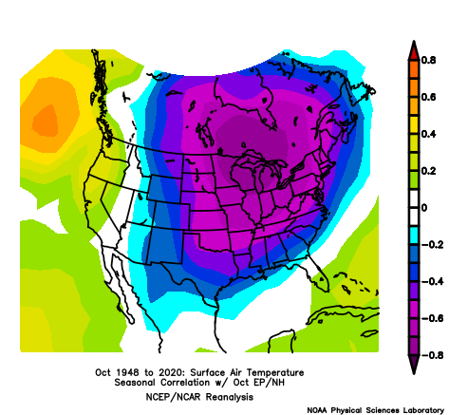
Previous Work
Has shown the value of teleconnections on temperature and precipitation trends.
But, has been limited to a specific region, a specific teleconnection, and/or specific variables.
This makes using teleconnection data for seasonal/long-term forecasting more challenging and time-consuming.

Slide 3
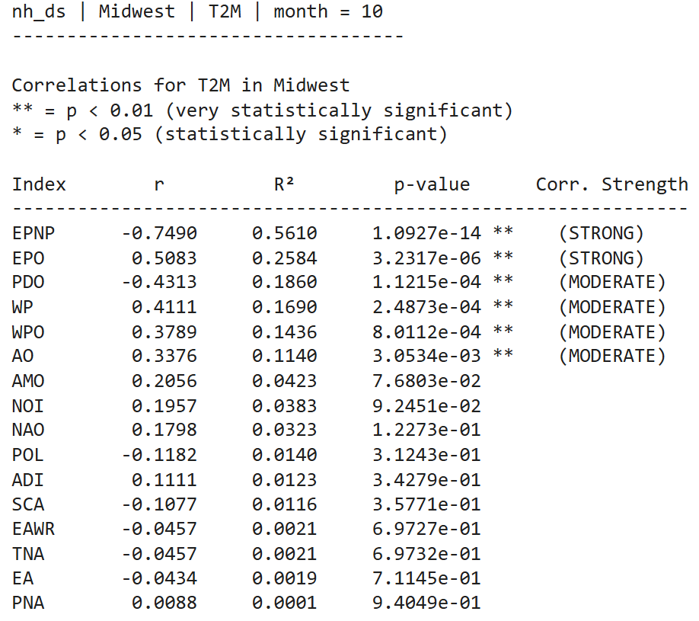
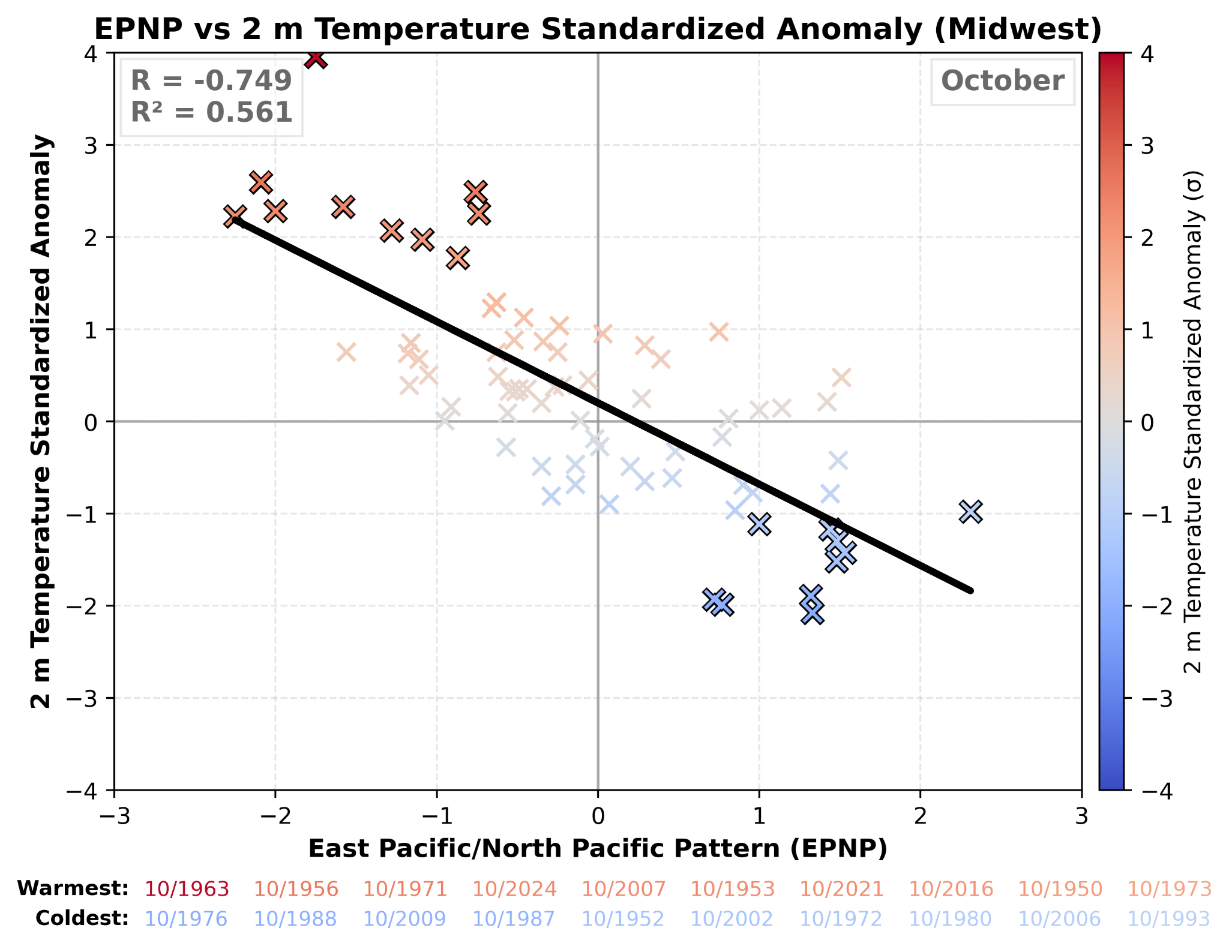
How we want to fix this
Multi-teleconnection analysis of temperature and precipitation trends
Concise visualizations that can be acted upon in an operational setting

Slide 4
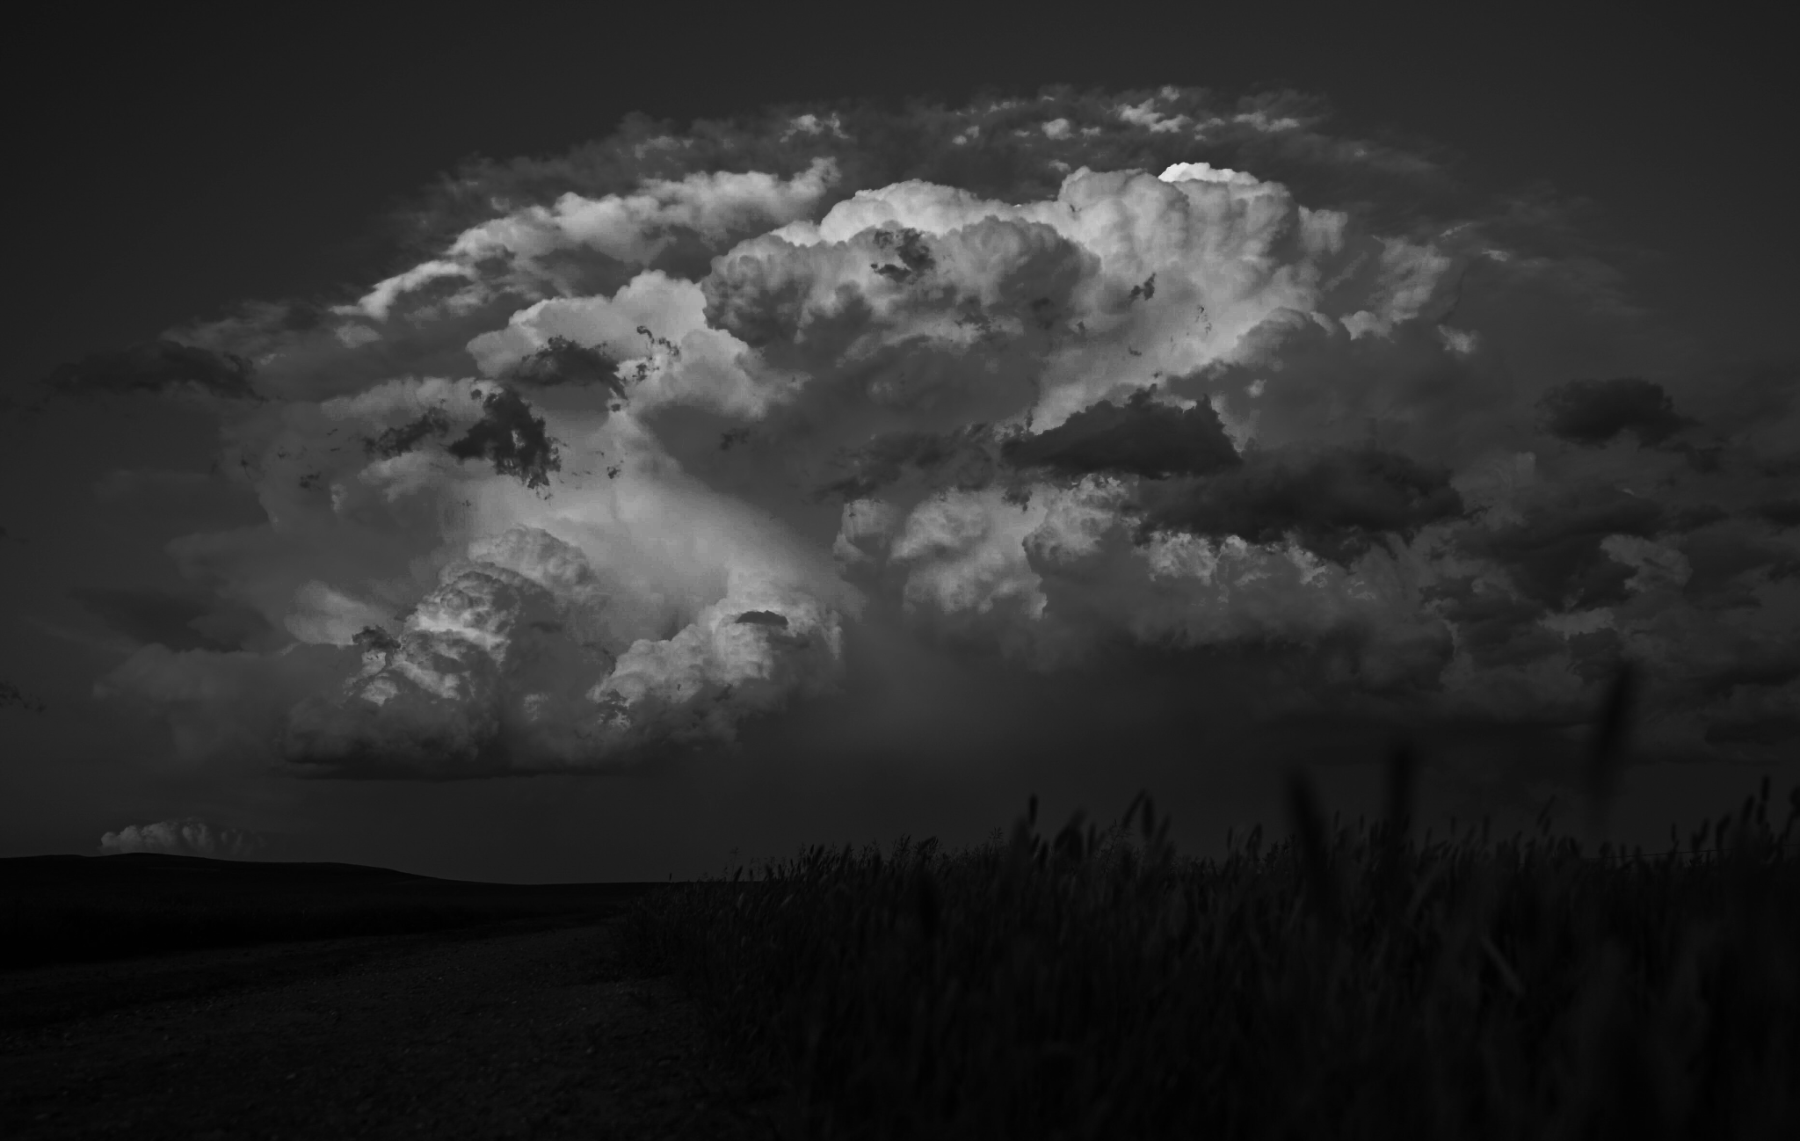
“Provide risk analysis and predictive insights to help global companies turn supply chains into business-changing, market-shifting, competition-crushing assets.”

